Slide 1
CS315 – Project Two (optional game title)
Spencer Smith
{ link to game source repo }

Slide 2
Milestone 1
By this point you should have completed:
Player movement and interaction
Level design and layout
Collectibles
One bit of interactivity
DONE

Slide 3
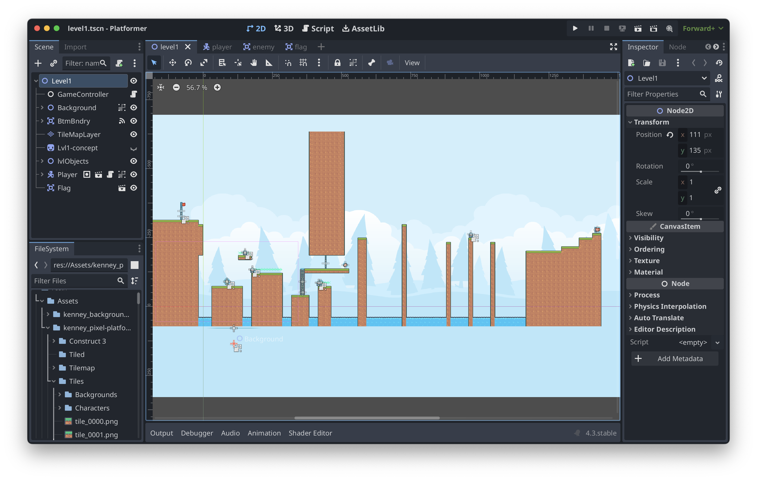
M1 – Screenshot / image

Slide 4
M1 – Question
How do I make the background repeat itself automatically?

Slide 5
M1 – Discussion
I can use a parallax background object to make my background repeat infinitely.
I should add some text in the levels about new items/abilities, rather than assuming that the player will know what stuff does.

Slide 6
M1– Technique Reflection
Starting with a blank slate is making it much easier for me to keep everything organized. I feel like, with the last project, ”taking over” someone else’s starting project made it much harder for me to keep everything clean. With this project, I started with nothing, so I have complete control over where everything goes, from the beginning.

Slide 7
Milestone 2
By the point you should have completed:
Doors / collectibles finished
User interface
Enemies added
Some “juice”

Slide 8
M2 – Screenshot / Image
Add a screenshot(s) of your project

Slide 9
M2 - Question
Add an open question you have about your project

Slide 10
M2 - Discussion
Discuss these elements of your game
Contrasts
Pattern / rhythm in gameplay (think visual and temporal)
Code layout and structure
Messaging between elements
When is object orientation getting in your way?

Slide 11
M2 Reflection
Delete and add your own reflection ( What are you struggling with? What is making more sense to you? What is the role of code in producing engaging game aesthetics?)

Slide 12
P2 – Final Reflection
Screenshot of final product here

Slide 13
P2 – Final Reflection
Delete and add a reflection on these elements of your project
Technique & Aesthetics
Major difficulties overcome
How you’d approach differently in the future

